Slide 1
Persediaan Belia Dalam Menceburi Sektor Korporat
‘Preparing the Young
for the Corporate world’
Wan Mohd Firdaus,
Young Corporate Malaysians

Slide 2

A business club for young Malaysian professionals
January 2008
CEO Series, Annual YCM Summits, Mentorship, CSR
www. ycm . org . my

Slide 3
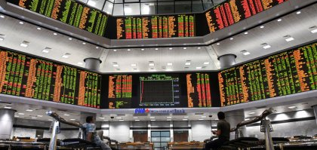
What is corporate Malaysia?
Bursa Malaysia
MNC’s
GLC’s. Government agencies?
SME? Startups?

Slide 4
Who are the young corporates/ professionals?
Klang Valley, Penang, Johor Bahru
University Graduates
21 to 30 years old

Slide 5
Question 1
Career or Job?

Slide 6
Question 2:
Small company or big company?

Slide 7
Question 3
Generalist or Specialist?

Slide 8
Preparation 1
Read the Big Picture

Slide 9
Preparation 2
Participate

Slide 10
Preparation 3
Boss or Mentors?

Slide 11
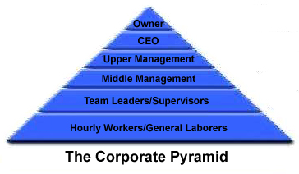
Reality 1
It’s a pyramid!

Slide 12
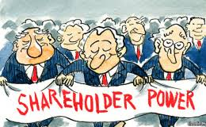
Reality 2
Owners will/Political will

Slide 13

Reality 3
“the Establishment”

Slide 14
Challenges for young Malaysians in the corporate world
Salary?
Work life Balance ?
Stay single or get married?
Trust and Opportunities?
Career ladder?
Cost of working - homes and transportation?
Quota?
Leave corporate Malaysia and build a startup?

